Slide 1
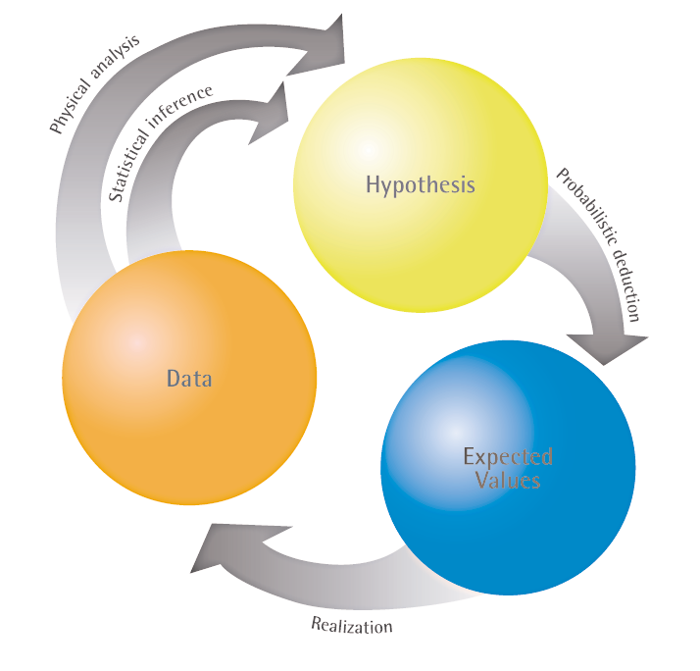
Department of Information Engineering (DINFO)
Measurement, Reliability and Safety Laboratory
Via di S. Marta 3 - 50139 Firenze +39 055 2758 503 http://www.labmaq.dinfo.unifi.it

Slide 2
Department of Information Engineering
Measurement, Reliability and Safety Laboratory
Contenuti /Current topics
Componenti elettronici - Affidabilità - Condizioni di riferimento per i tassi di guasto e modelli per la loro conversione in funzione delle sollecitazioni
Electronic components - Reliability - Reference conditions for failure rates and stress models for conversion
Banche dati di affidabilità – Modelli generici per la predizione di affidabilità di componenti elettronici
Reliability data handbook – Universal model for reliability prediction of electronics components, PCBs and equipment
Obiettivi / Main results
Calcolo del tasso di guasto e valutazione MTBF / Failure rate and MTBF
Report di affidabilità / Reliability reporting activity
Riferimenti / Main sources
IEC TR 62380
CEI EN 61709
MIL HDBK 217 F - TELCORDIA SR 332

Slide 3
Department of Information Engineering
Measurement, Reliability and Safety Laboratory
Modelli/ Models
“Reliability is the probability that an item can perform its intended function for a specified interval under stated conditions” [MIL-HDBK-338B].
Reliability prediction models (MIL-HDBK-217, TELCORDIA, IEC 61709, IEC TR 62380 ) offer standard equations that allow you to calculate the failure rate of components by gathering information regarding component data and parameters. These parameters often include environment, temperature, quality, and stress. These parameters are used to establish pi factors, which are the variables used in the reliability prediction equations.
Once the individual failure rates for components are established, in a series model a simple summation of the component failure rates provides the failure rate for the higher level assemblies and system.
The component failure rate under operating conditions is calculated as follows:
λ = λref × π U × π I × π T × π E × π S × π ES

Slide 4
Department of Information Engineering
Measurement, Reliability and Safety Laboratory
Impiego / Role
The reliability prediction may be used as a guide to improvement by showing the highest contribution to failure
The predicted will also help evaluate the significance of reported failure to determine whether the number of failures Is commensurate with the number of components used in the system
Maintenance strategy planners can make use of the relative probability of a failure’s location, based on predictions, to minimize downtime. Reliability predictions are also used to evaluate the probabilities of failure events described in a failure modes, effects and criticality analysis (FMECAS).

Slide 5
Department of Information Engineering
Measurement, Reliability and Safety Laboratory
Avvertenze / Limitations
The first limitation is that the failure rate models are point estimates which are based on available data. Some extrapolation during model development is possible, but the inherently empirical nature of the models can be severely restrictive.
A reliability prediction should never be assumed to represent the expected field reliability as measured by the user (i.e., Mean-Time-Between-Maintenance, Mean-Time-Between-Removal, etc.). This does not negate its value as a reliability engineering tool; note that none of the applications discussed above requires the predicted reliability to match the field measurement.
A basic limitation of reliability prediction is its dependence on correct application by the user. Those who correctly apply the models and use the information in a conscientious reliability program will find the prediction a useful tool. Those who view the prediction only as a number which must exceed a specified value can usually find a way to achieve their goal without any impact on the system.

Slide 6
Department of Information Engineering
Measurement, Reliability and Safety Laboratory
MIL HDBK 217
DEPARTMENT OF DEFENSE WASHINGTON DC 20301 RELIABILlTY PREDICTION OF ELECTRONIC EQUIPMENT - This standardization handbook was developed by the Department of Defense with the assistance of the military departments, federal agencies, and industry
establish and maintain consistent and uniform methods for estimating the inherent reliability (i.e., the reliability of a mature design) of military electronic systems. It provides a common basis for prediction for military electronic systems and equipment
establishes a common basis for comparing and evaluating reliability predictions of related or competitive designs
is a tool to increase the reliability of the equipment being designed
Metodi / Methods
Part Count
Part Stress

Slide 7
Department of Information Engineering
Measurement, Reliability and Safety Laboratory
Part Count
Requires less information, generally part quantities, quality level, and the application environment. This method is applicable during the early design phase and during proposal formulation. In general, the Parts Count Method will usually result in a more conservative estimate (i.e. higher failure rate) of system reliability than the Parts Stress Method.
Part Stress
The Part Stress Analysis Method requires a greater amount of detailed information and is applicable during the later design phase when actual hardware and circuit are being designed
Data should be obtained from the following sources in the given order of preference:
user data
manufacturer data
handbook data

Slide 8
Department of Information Engineering
Measurement, Reliability and Safety Laboratory
Esempio / Application
Part Count su modulo trasmissione 3G modello MILHDBK 217
Part Stress su modulo trasmissione 3G modello MILHDBK 217
Modello Telcordia SR 332
3G Module - Value | Result 217 PS | Result 217 PC | Result Telcordia
Failure Rate, Predicted | 5,674812 | 11,842148 | 2,341089
MTBF, Predicted | 176217,306 | 84444,14209 | 427151,6611
Reliability, Predicted | 0,999433 | 0,998816 | 0,999766
Availability | 1 | 1 | 1
MTTR | 0 | 0 | 0

Slide 9
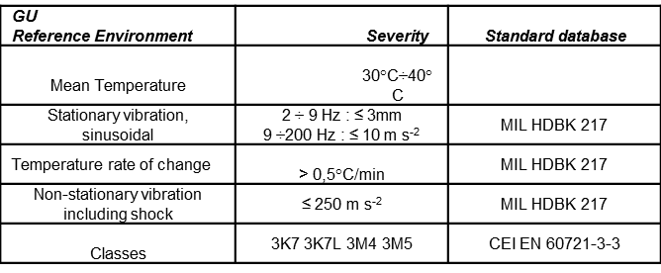
Department of Information Engineering
Measurement, Reliability and Safety Laboratory
Environment
The environment may be described in terms of several types of parameters.
IEC 60721-3-3 describes the environment in terms of
climatic conditions,
special climatic conditions,
biological conditions,
chemically active substances,
mechanically active substances,
mechanical conditions (both static and dynamic).

Slide 10
Department of Information Engineering
Measurement, Reliability and Safety Laboratory
Component Category | Design Stress | IEC 61709 Stress
Resistor | 20% ÷ 25% Power Ratio | 50 % of rated voltage at 40 °C
Capacitor (excluding electrolytic) | 10% Voltage Ratio | 50 % of rated voltage at 40 °C
Capacitor (Al electrolytic) | 40% Voltage Ratio Corrective factors | 80 % of rated voltage at 40 °C
Semiconductor | 70% Voltage Ratio | 50% Voltage Ratio
Switching | 50% Voltage Ratio | 50% Voltage Ratio
Zener,regulator | 70% Voltage Ratio | 70% Voltage Ratio
IC Linear | 30% Power Ratio/T.rise ≤ 20°C | 70% Power Ratio/T.rise ≤ 20°C
IC Logic all | self-heating | rated stress self-heating
IC Logic (CPU,FPGA) | self-heating | rated stress self-heating
Inductors | 20 % of rated power at 40 °C | 50 % of rated power at 40 °C
Quartz | rated stress | rated stress
Connectors | rated stress | 50 % of rated current
Relays | rated stress | 1 cycle/hour
Stress

Slide 11
Department of Information Engineering
Measurement, Reliability and Safety Laboratory
Profilo di missione / Mission profile
Example 1 - Telecoms
There is only one annual working phase to consider for a permanent working.
Table is given for a permanent working. Values for "ground; stationary; non weather protected"(Ground; fixed for Mil-HDBK-217F) are given for the French climate, but other climates can be calculated.
Environment types | Equipment types | (tae)I °C | (tac)i °C | Π i | Π ON | Π OFF | N1 cycles/year | DT °C/cycle
Ground; benign: (GB) | Switching | 20 | 30 | 1 | 1 | 0 | 365 | 0
Ground; benign: (GB) | Transmitting | 20 | 40 | 1 | 1 | 0 | 365 | 0
Ground; fixed: (GF) | Transmitting and access | 11 | 31 | 1 | 1 | 0 | 365 | 8
Example 2 - Automotive

Slide 12
Department of Information Engineering
Measurement, Reliability and Quality Laboratory
MTBF di missione / Mission profile MTBF

Slide 13
Department of Information Engineering
Measurement, Reliability and Safety Laboratory
MTBF di missione / Mission profile MTBF
Example – Reliability data– MTBF vs Temperature
Case study – Rolling Stock equipment
Example – Reliability Report
Case study – Guideline for DfR

Slide 14
Department of Information Engineering
Measurement, Reliability and Safety Laboratory
Riassumendo: Obiettivi delle predizioni di affidabilità
Nella fase di progetto permettono l’eliminazione di criticità esistenti indirizzando:
la ripartizione dell’affidabilità tra le parti del sistema (allocazione)
l’ottimizzazione delle condizioni di impiego (stress)
l’ottimizzazione del progetto termico (temperatura)
il confronto di soluzioni alternative e varianti di progetto
Costituiscono gli elementi base per ricavare la probabilità degli eventi di guasto descritti nelle tecniche FMECA
In una fase successiva di analisi di sistema le previsioni di affidabilità sono elemento fondamentale nell’analisi di disponibilità , manutenibilità e nel dimensionamento delle scorte (logistica)
Infine, le previsioni di affidabilità costituiscono un riferimento che permette di monitorare le verifiche di affidabilità (prove e dimostrazioni) ed evidenziare eventuali comportamenti anomali al fine di porvi rimedio (analisi dei guasti).

Slide 15
Department of Information Engineering (DINFO)
Measurement, Reliability and Safety Laboratory
Via di S. Marta 3 - 50139 Firenze +39 055 2758 503 http://www.labmaq.dinfo.unifi.it

